Slide 1
UNIT 01
LESSON AB

Slide 2
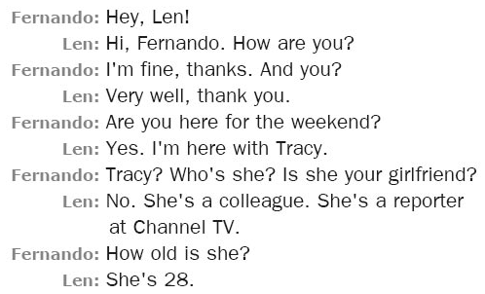
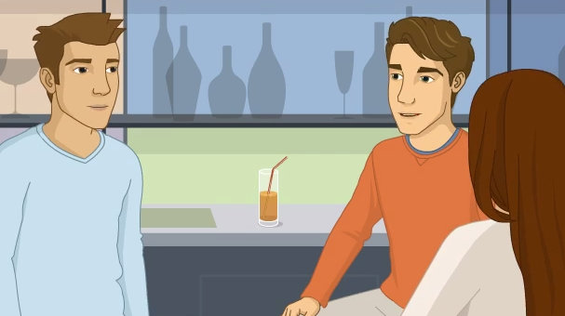
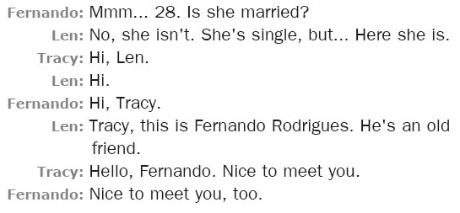

Slide 3
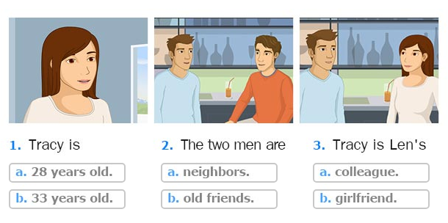
a. 28 years old.
a. colleague.
b. old friends.

Slide 4
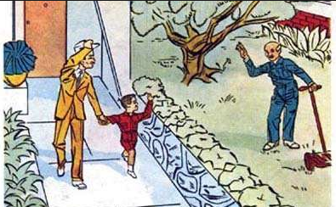
What are they?
neighbors
best friends

Slide 5
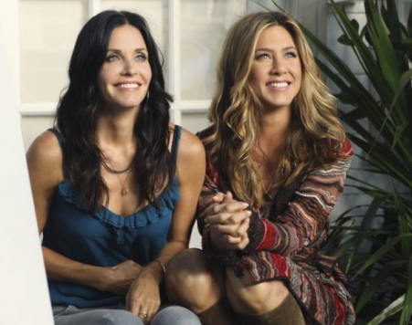
What are they?
neighbors
best friends

Slide 6

Guess! (adivina)
ebts rdefnis

Slide 7
Guess!
onbeisghr

Slide 8
Guess!
lcgeolaesu

Slide 9
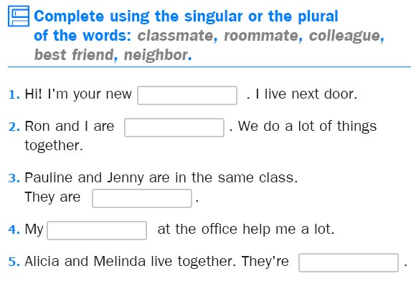
neighbor
best friends
classmates
colleague
roommates

Slide 10
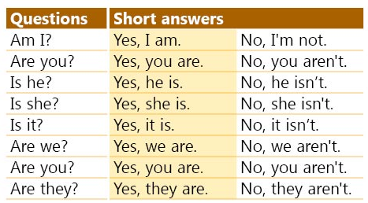
VERB TO BE

Slide 11
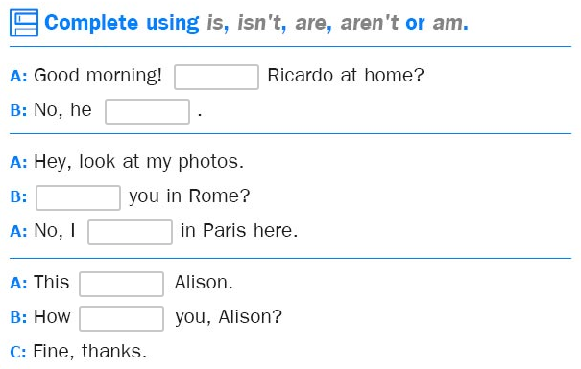
Is
isn’t
Are
am
is
are

Slide 12
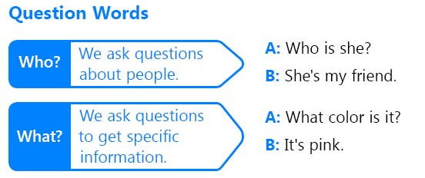

Slide 13
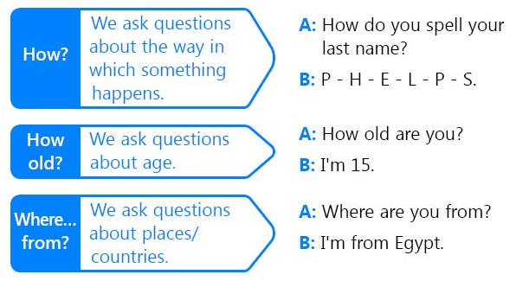

Slide 14
What is the correct verb?
This ___ my new laptop.
am
is
are

Slide 15
This ins’t my new laptop.
Is this my new laptop?
Yes, it is.
No, it isn’t.

Slide 16
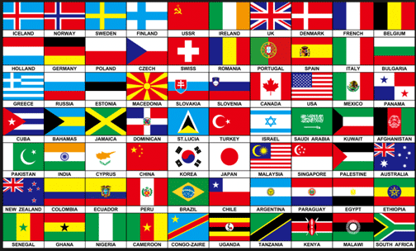
Vocabulary: Countries and nationalities

Slide 17

Let’s learn!

Slide 18




Vocabulary: Countries and nationalities
Mexico => Mexican
Brazil => Brazilian
China => Chinese
UK => British

Slide 19




Vocabulary: Countries and nationalities
Italy => Italian
Russia => Russian
Japan => Japanese
USA => American

Slide 20




Vocabulary: Countries and nationalities
Peru => Peruvian
Spain => Spanish
France => French
Colombia => Colombian

Slide 21




Vocabulary: Countries and nationalities
Chile => Chilean
Argentina => Argentinian
Ireland => Irish
Greece => Greek

Slide 22
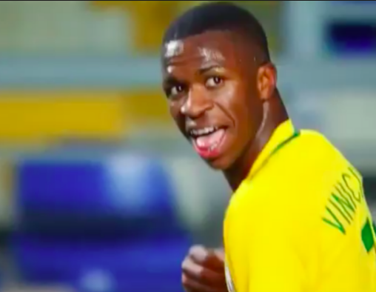
Where is he from?
¿De donde es?
He is from Brazil.
He’s Brazilian.

Slide 23
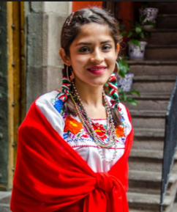
Where is she from?
She is from Mexico.
She’s Mexican.

Slide 24
And you…
Where are you from?
I am from Peru.
I´m Peruvian.

Slide 25
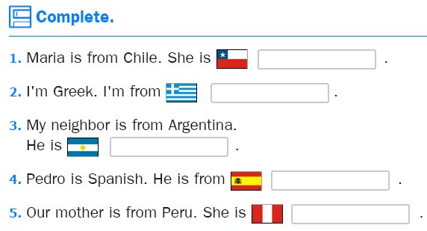
Chilean
Greece
Argentinian
Spain
Peruvian

Slide 26
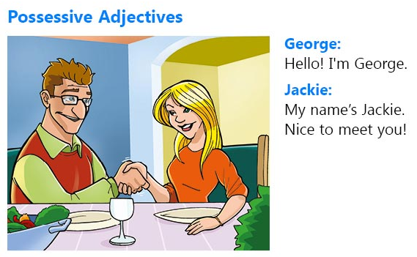
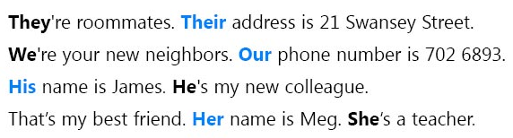

Slide 27
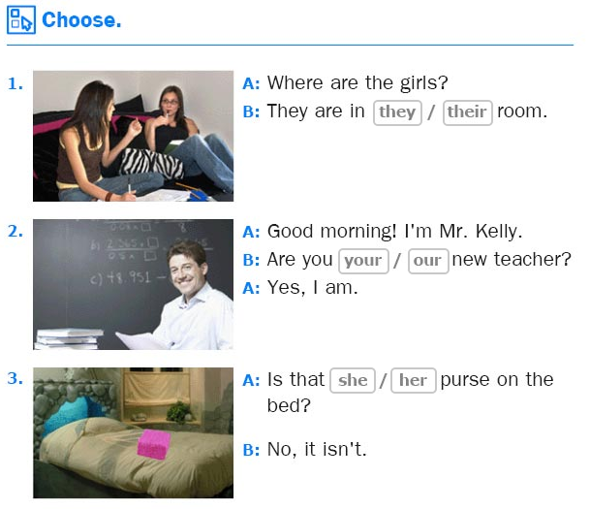
their
our
her

Slide 28
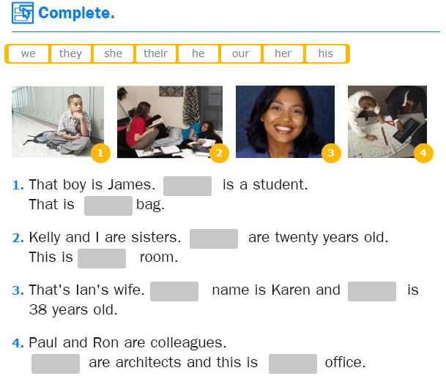
He
his
We
our
Her
she
They
their

